Slide 1
Production and Operations Management Systems
Work Load Assessment (Forecasting)

Slide 2
After reading this chapter, you should be able to:
Describe the importance of forecasting
Explain various components of a time series
Choose an appropriate forecasting model
Perform regression analysis
Identify cause-effect relationships
Analyze and evaluate forecasting errors
Use the DELPHI method
Pool information for multiple forecasts
Describe product life cycle stages

Slide 3
Introduction
Forecasts of the demand for products and services are business essentials.
Examples include:
patients in a hospital
students in a college
customers in a grocery store
cars to be manufactured etc.

Slide 4
Introduction (continued)
Demand forecasts set the agenda for how the entire company will:
use its people
commit its resources
call on outside suppliers
plan its work schedules

Slide 5
Introduction (continued)
The Rivet and Nail Factory has to forecast sales of products to develop departmental schedules for the next production period.
The Mail Order Company has to forecast demand in order to have the right number of trained agents and operators in place.
Ford Motor Company has to forecast car sales so that dealer stocks are of reasonable size for every model.

Slide 6
Introduction (continued)
Forecasts provide information to coordinate demands for products and services with supplies of resources that are required to meet the demands.
This is reactive planning.

Slide 7
Introduction (continued)
Modify forecasts to influence the future rather than just accepting forecasts as inevitable truths.
Such an approach helps to better fit production capabilities (short- and long-term) to marketing possibilities.
This is proactive planning

Slide 8
Introduction (continued)
How well can one forecast the future?
The answer depends on the stability of the pattern of the time series for the events being studied.
The underlying pattern may be hard to find, but not impossible.
When a pattern is found, the question remains, how long will it persist? When will it change? Forecasters are willing to accept the challenge.

Slide 9
Introduction (continued)
Mathematical equations are used for forecasting.
Equations do not make forecasts “the truth.”
Good forecasting can be done without mathematics.
Further, with or without mathematics, no forecast is ever guaranteed.

Slide 10
Time Series and Extrapolation
A time series is a stream of data (e.g., demand).
Data are recorded at different time periods – monthly, weekly, daily, etc.
Forecasters predict (by extrapolation) the value(s) at a future time.
The pattern of the series is considered to be time-dependent. External causes are not brought into the picture.

Slide 11
Time Series and Extrapolation continued
The data in time series may consist of several different kinds of variations.
Important among them are:
random variations
increasing or decreasing trend
seasonal variations

Slide 12
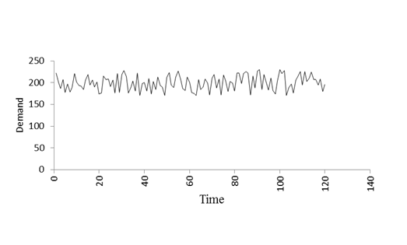
Time Series (Random Variations)
There are no specific assignable causes for random variations.
Values are a result of the economic environment and the market place.

Slide 13
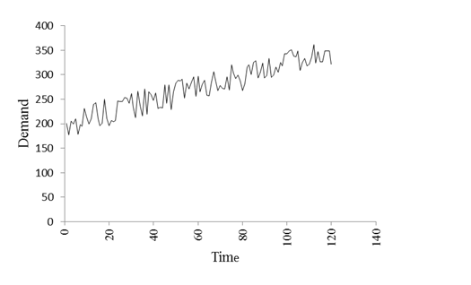
Time Series (Random Variations and Increasing Trend)
There is a constant rate of change (increasing values) as time goes by.

Slide 14
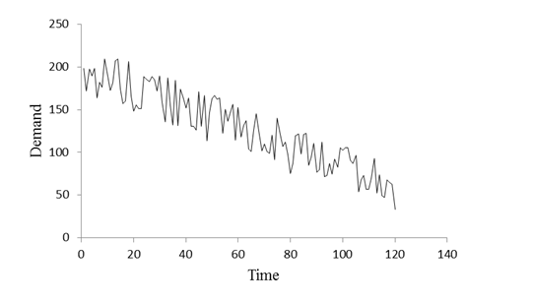
Time Series (Random Variations and Decreasing Trend)
There is a constant rate of change (decreasing values) as time goes by.

Slide 15
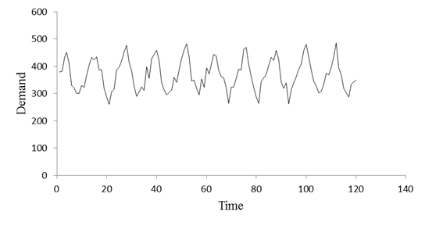
Time Series (Random Variations and Seasonal Variations)
Seasonal (cyclical) variations may also be present.
Examples: demand for resort hotels & home heating oil.

Slide 16
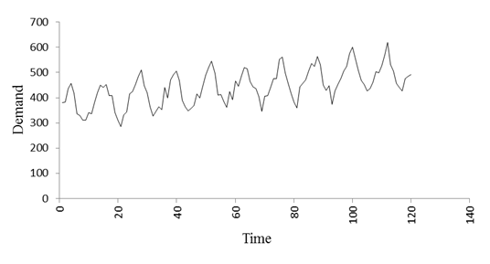
Time Series (Random Variations, Seasonal Variations and Increasing Trend)
All three components – random variations, an increasing (or decreasing) trend, and seasonal variations (cycles) may be present simultaneously in a time series.

Slide 17
Forecasting Methods for Time Series
The following techniques are discussed:
Moving Average
Weighted Moving Average
Exponential Smoothing
Seasonal Forecasting
Trend Analysis

Slide 18
Moving Average
A n-month moving average is the sum of the observed values during the past n months divided by n.
Moving Average Method n =3
Month | Sales | Forecast | Formula
1 | 100
2 | 80
3 | 90
4 | 110 | 90.00 | =(100+80+90)/3
5 | 100 | 93.33 | =(80+90+110)/3
6 | 110 | 100.00 | =(90+110+100)/3
7 | 95 | 106.67 | =(110+100+110)/3
8 | 115 | 101.67 | =(100+110+95)/3
9 | 120 | 106.67 | =(110+95+115)/3
10 | 90 | 110.00 | =(95+115+120)/3
11 | 105 | 108.33 | =(115+120+90)/3
12 | 110 | 105.00 | =(120+90+105)/3

Slide 19
Weighted Moving Average
The weighted moving average (WMA) makes forecasts more responsive to the most recent actual occurrences (e.g., demand).
The most recent n periods are used in forecasting.
Each period is assigned a weight between 0 and 1.
The total of all weights adds up to one (1).

Slide 20
Weighted Moving Average (using monthly demands)
Example:
Forecast (4) = 0.2*(Demand 1) + 0.3*(Demand 2) + 0.5*(Demand 3)
Weighted Moving Average Method n=3 |  |  |  | Weights
 |  |  |  | 0.2
 |  |  |  | 0.3
Month | Sales | Forecast | Calculation | 0.5
1 | 100
2 | 80
3 | 90
4 | 110 | 89.00 | = 0.2*100 + 0.3*80 + 0.5*90
5 | 100 | 98.00 | = 0.2*80 + 0.3*90 + 0.5*110
6 | 110 | 101.00 | = 0.2*90 + 0.3*110 + 0.5*100
7 | 95 | 107.00 | = 0.2*110 + 0.3*100 + 0.5*110
8 | 115 | 100.50 | = 0.2*100 + 0.3*110 + 0.5*95
9 | 120 | 108.00 | = 0.2*110 + 0.3*95 + 0.5*115
10 | 90 | 113.50 | = 0.2*95 + 0.3*115 + 0.5*120
11 | 105 | 104.00 | = 0.2*115 + 0.3*120 + 0.5*90
12 | 110 | 103.50 | = 0.2*120 + 0.3*90 + 0.5*105

Slide 21
Exponential Smoothing
The Exponential Smoothing (ES) method forecasts the demand for a given period t by combining the forecast of the previous period (t-1) and the actual demand of the previous period (t-1).
The actual demand for the previous period is given a weight of α and the forecast of the prior period is given a weight of (1 - α).
α is a smoothing constant whose value lies between 0 and 1 (0 ≤ α ≤ 1).

Slide 22
Exponential Smoothing (continued)
The equation for the forecast for period t is:
Forecast (t) = α*Actual Demand (t-1) + (1- α )*Forecast (t-1).
The equation can also be written as:
Forecast (t) = Forecast (t-1) + α*{Actual Demand (t-1)–Forecast (t-1)}

Slide 23
Exponential Smoothing (continued)
Example: F(3) = F(2) + α*{(A(2) – F(2)} = 100 + 0.2*(80 – 100) = 96.
Exponential Smoothing Method (sales are actual sales indicated by A in equation)
 | alpha = | 0.2
Month | Sales | Forecast | Comment and Calculation
1 | 100 | 100 | Forecast for period 1 should be available before starting the calculations. If it is not given then set it equal to the sales of period 1.
2 | 80 | 100.00 | =(100 + 0.2(100 -100))
3 | 90 | 96.00 | =(100 + 0.2(80 -100))
4 | 110 | 94.80 | =(96 + 0.2(90 -96))
5 | 100 | 97.84 | =(94.8 + 0.2(110 -94.8))
6 | 110 | 98.27 | =(97.84 + 0.2(100 -97.84))
7 | 95 | 100.62 | =(98.27 + 0.2(110 -98.27))
8 | 115 | 99.50 | =(100.62 + 0.2(95 -100.62))
9 | 120 | 102.60 | =(99.5 + 0.2(115 -99.5))
10 | 90 | 106.08 | =(102.6 + 0.2(120 -102.6))
11 | 105 | 102.86 | =(106.08 + 0.2(90 -106.08))
12 | 110 | 103.29 | =(102.86 + 0.2(105 -102.86))

Slide 24
Seasonal Forecast Step 1
Quarterly demand for last four years is given in the table below.
We use a 5-step process to forecast.
Step 1: Find average quarterly demand for each quarter.
Demand
Quarter | Year 1 | Year 2 | Year 3 | Year 4
Fall | 2530 | 2690 | 2790 | 2860
Winter | 2300 | 2420 | 2410 | 2600
Spring | 1900 | 2000 | 2105 | 2175
Summer | 1510 | 1775 | 1875 | 1945
Average | 2060 | 2221 | 2295 | 2395
Formula | =(1510 + 1900 + 2300 + 2530)/4) | =(1775 + 2000 + 2420 + 2690)/4) | =(1875 + 2105 + 2410 + 2790)/4) | =(1945 + 2175 + 2600 + 2860)/4)

Slide 25
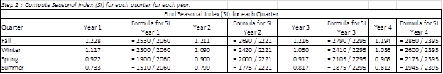
Seasonal Forecast Step 2
Step 2: Compute Seasonal Index (SI) for each quarter for each year.

Slide 26
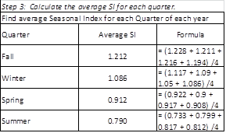
Seasonal Forecast Step 3
Step 3: Calculate the average SI for each quarter.

Slide 27

Seasonal Forecast Step 4
Step 4: Calculate the average quarterly demand for next year.
First, the yearly demand has to be estimated or calculated for next year using one of the forecasting techniques.
Suppose the estimated demand is 2,800.
Therefore, the average quarterly demand = 2,800/4 = 700. The calculations are shown below.

Slide 28
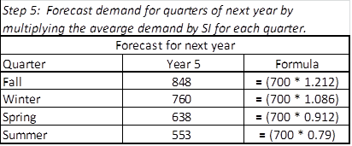
Seasonal Forecast Step 5
Step 5: Forecast demand for the four quarters of next year.
Multiply the average demand by the SI for each quarter.
For example, forecast for Spring quarter = 638 = 700*0.912.

Slide 29
Time Series Analysis – Trend Line
If the time series exhibits an increasing or decreasing trend then a trend analysis is more appropriate.
A trend line defines the relationship between demand forecast and the time period by the following equation.
Y = a + bX, where, Y is the demand forecast and X is the time period.
X is the independent variable and Y is the dependent variable since the demand depends on the time period.

Slide 30
Time Series Analysis – Trend Line
(continued)
In the equation, Y = a + bX, a is the intercept on the Y-axis. a gives the value of demand (variable Y) when X = 0.
The slope of the line is b which gives the change in the value of demand (variable Y) for a unit change in the value of X.
The “Intercept” and “Slope” functions in Excel are used to calculate a and b respectively.

Slide 31
Time Series Analysis – Trend Line
(continued)
Example: Consider the demand data given in the table below.
The Excel functions give b = 8.65 and a = 2.73.
Use them in equation, Y = a + bX, to make a forecast.
For example, for period 11 (X = 11),
Forecast = 2.73 + 11*8.65 = 97.87.
Similarly, for period 12,
Forecast = 2.73 + 12*8.65 = 106.52.

Slide 32
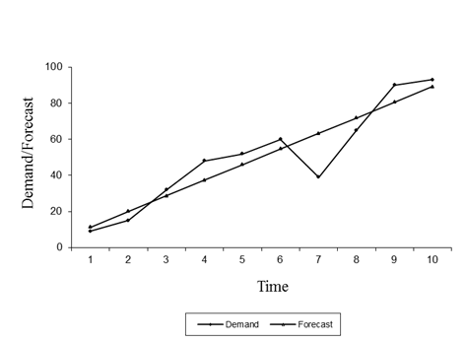
Time Series Analysis – Trend Line
(continued)
The forecasts (values on straight line) and the actual demand (values on zigzag line) have been plotted in the following figure.

Slide 33
Time Series Analysis – Trend Line
(continued)
For any given time period, the difference between the forecast (values on straight line) and the actual demand (values on zigzag line) gives the error in that period.
The trend analysis method minimizes the sum of the squares of these errors in calculating the values of a and b.

Slide 34
Regression Analysis
Regression Analysis establishes a relationship between two sets of numbers that are time series.
For example, when a series of Y numbers (such as the monthly sales of cameras over a period of years) is causally connected with the series of X numbers (the monthly advertising budget), then it is beneficial to establish a relationship between X and Y in order to forecast Y.
In regression analysis X is the independent variable and Y is the dependent variable.

Slide 35
Regression Analysis (continued)
The regression analysis gives the relationship between X and Y by the following equation.
Y = a + bX,
  where, a is the intercept on the Y-axis (value of the variable Y when X = 0); and b is the slope of the line which gives the change in the value of variable Y for a unit change in the value of X.
The “Intercept” function in Excel calculates a and the “Slope” function in Excel is used to find the value of b.

Slide 36
Regression Analysis (continued)
Example: Use the data given in the following table for ten-pairs of X and Y.
The Excel functions give b = 50.23 and a = 62.44.
Use them in equation, Y = a + bX, to forecast.
Suppose X = 15, then
Forecast = 62.44 + 50.23*15 = 815.84.
Observation Number | 1 | 2 | 3 | 4 | 5 | 6 | 7 | 8 | 9 | 10
Independent Variable (x) | 10 | 12 | 11 | 9 | 10 | 12 | 10 | 13 | 14 | 12
Dependent Variable (y) | 400 | 600 | 700 | 500 | 800 | 700 | 500 | 700 | 800 | 600

Slide 37
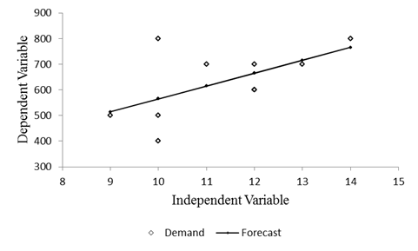
Regression Analysis continued
The forecasts (values on straight line) and the actual demand data points have been plotted in the following figure.

Slide 38
Regression Analysis (continued)
For any given time period, the difference between the forecast values and the actual demand gives the error in that period.
The regression analysis minimizes the sum of the squares of these errors in calculating the values of a and b.

Slide 39
Regression Analysis (continued)
An assumption that is generally made in regression analysis is that the relationship between the correlate pairs is linear.
However, if nonlinear relations are hypothesized, there are strong, but more complex methods for doing nonlinear regression analyses.

Slide 40
Correlation Coefficient
An important prerequisite to use regression analysis is the existence of a causal relationship between X and Y.
A correlation coefficient (r) shows the extent of correlation of X with Y, where r can take on values from “–1” to “+1”.

Slide 41
Correlation Coefficient (continued)
When r = “–1”, X and Y are perfectly correlated going in opposite directions. As X gets large, Y gets small, and vice versa.
When r = 0, there is no correlation between X and Y.
When r = +1, X and Y are perfectly correlated going in the same direction.
The correlation coefficient can be found by using Excel’s built-in function “Correl”.

Slide 42
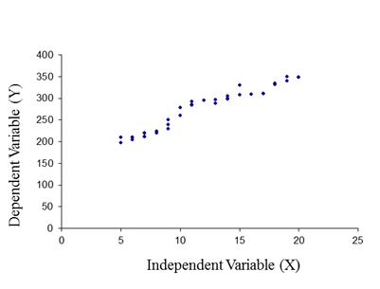
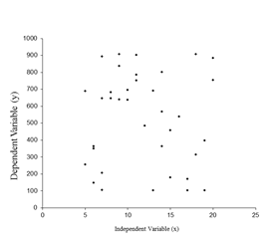
Correlation Coefficient (continued)
Scatter diagrams (shown below) are useful visual aids to intuit whether there is a relationship between X and Y. The r number is definitive.
r = -0.04
Indicates an absence of any relationship. We should not use regression analysis for this time series.
r = 0.97
Indicates an almost perfect relationship. This time series is a good candidate for regression analysis.

Slide 43
Coefficient of Determination
The coefficient of determination (r²), where r is the value of the coefficient of correlation, is a measure of the variability that is accounted for by the regression line for the dependent variable.
The coefficient of determination always falls between 0 and 1.

Slide 44
Coefficient of Determination (continued)
For example, if r = 0.8, the coefficient of determination is r² ⁼ 0.64 meaning that 64% of the variation in Y is due to variation in X.
The remaining 36% variation in the value of Y is due to other variables.
If the coefficient of determination is low, multiple regression analysis may be used to account for all variables affecting the independent variable Y.

Slide 47
Error Analysis
The forecasting errors are computed as,
Error (t) = Demand (t) – Forecast (t).
Underestimate: Demand is greater than the forecast. Error term is positive.
Overestimate: Demand is smaller than the forecast. Error term is negative.

Slide 48
Error Analysis (continued)
The most commonly used method to measure errors is Mean Absolute Deviation (MAD).
To calculate MAD, take the sum of the absolute measures of the errors and divide that sum by the number of observations.
MAD treats all errors linearly.

Slide 49
Error Analysis (continued)
Example: Consider the demand and forecast given for 10 periods in the table below.
The sum of the absolute errors for 10 periods is 171. Therefore, MAD = 171/10 = 17.10.
Period | Demand | Forecast | Error | Absolute Error
1 | 212 | 206.0 | 6.0 | 6.0
2 | 224 | 207.0 | 17.0 | 17.0
3 | 220 | 210.0 | 10.0 | 10.0
4 | 211 | 212.0 | -1.0 | 1.0
5 | 198 | 205.0 | -7.0 | 7.0
6 | 236 | 209.0 | 27.0 | 27.0
7 | 219 | 224.0 | -5.0 | 5.0
8 | 296 | 238.0 | 58.0 | 58.0
9 | 280 | 249.0 | 31.0 | 31.0
10 | 252 | 261.0 | -9.0 | 9.0
 |  | Total | 127.0 | 171.0

Slide 50
Error Analysis (continued)
To select a forecasting method, say exponential smoothing, calculate the values of MAD choosing different values of α. The value of α that minimizes MAD will be selected.
Similarly, for moving average, find MAD for different values of n. The n that minimizes MAD will be selected.
A similar procedure can be used with the weighted moving average method to find the best combination of weights.

Slide 51
Product Life Cycle Stages
All products and services go through the following four stages:
  Introduction to the market
  Growth of volume and share
  Maturation, where maturity is the phase of relative equilibrium
  Decline occurs, because of deteriorating sales; decline leads to restaging or withdrawal
The production system’s capabilities need to be adjusted with changes or transitions between stages.

Slide 52
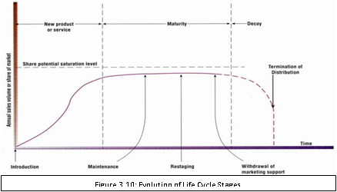
Product Life Cycle Stages (continued)
Life cycle stages provide a classification for understanding the nature of evolving demand trends that will occur over time.

Slide 53
Product Life Cycle Stages (continued)
During the introductory phase, demand is led by the desire to “fill the pipeline.” This means getting product into the stores or warehouses—wherever it must be to supply the customers.
When growth starts to occur, there is a trend line of increasing sales. The trick is to estimate how fast demand will increase over time and for how long a period growth will continue.

Slide 54
Product Life Cycle Stages (continued)
When the new product or service stops growing, it is considered mature. This means—its volume is stabilized at the saturation level for that brand. The competitors have divided the market, and only extraordinary events, such as a strike at a competitor’s plant, are able to shift shares and volumes.
Finally, the product begins to lose share, volume drops, and, depending on the strategy, the product is either restaged or terminated.

Slide 55
The Delphi Method
Delphi is a forecasting method that relies on expert estimation of future events.
The experts submit their opinions to a single individual (leader of the group) who maintains anonymity of responses.
The leader combines the opinions into a report which is disseminated to all participants. We hope the report is fair and balanced.
The participants are asked whether they wish to reevaluate and alter their previous opinions in the face of the body of opinion of their colleagues.

Slide 56
The Delphi Method (continued)
Gradually, the group is supposed to move toward consensus. If it does not, at the least, a set of different possibilities can be presented to management.
The Delphi method is meant to put all participants on an equal footing with respect to getting their ideas heard.
There is no evidence that the Delphi method provides forecasts (and/or predictions) with smaller errors than other techniques.
It is apparent that managers gain greater perspective about forces that should be considered when they are contemplating possible outcomes. That is a positive benefit of Delphi.

Slide 57
Thank you

